Slide 1
Keylogger & SECURITY
PRESEnt BY:
SEETHANA

Slide 2
WHAT IS KEY LOGGER?
A key logger is a program that runs in the background or hardware, recording all the keyst PIG
Once keystrokes are logged, they are hidden in machine for later retrieval, or shipped raw to the attacker
Attacker checks files carefully in the hopes of either finding passwords, or possibly other useful information.

Slide 3
Key loggers, as a surveillance tool, are often u ed by employers to ensure employees use work com ters for business purposes only.
Such systems are also highly useful for law enforcement and espionage
Keystroke logging can be achieved by both hardware and software means.

Slide 4
There are two types of keyloggers :
I. Hardware Keylogger
2. Software Keylogger

Slide 5
HARDWARE KEYLOGGER
Hardware keyloggers are used for keystroke logging, a method of capturing and recording computer users' keystrokes, including sensitive passwords.
Generally, recorded data is retrieved by typing a special password into a computer text editor.
The hardware keyloggers plugged in between the keyboard and computer detects that the password has been typed and then presents thecomputer with "typed" data to produce a menu.

Slide 6
HARDWARE KEYLOGGERS
Come in three types:
Inline devices that are attached to the keyboard cable.
Devices which can be installed inside standard keyboards.
Replacement keyboards that contain the key logger already built-in.

Slide 7
SOME HARDWARE KEYLOGGERS
Hardware KeyLogger Stand-alone Edition
a tiny hardware device that can be attached I between a keyboard and a computer.
Hardware KeyLogger Keyboard Edition
looks and behaves exactly like a normal keyboa but it keeps a record of all keystrokes typed on it.
KeyGhost Hardware Keylogger
a tiny hardware device that can be attached in between a keyboard and a computer.
KeyKatcher Keystroke Logger
a tiny hardware device that can be attached in between a keyboard and a computer.

Slide 8
Advantages :
1. Antivirus techniques cannot catch these.
2. Work on all computing platforms.
Disadvantages :
l. It can be spotted by a suspicious user.

Slide 9
SOFTWARE KEYLOGGER
Software keyloggers track system , collect keystoke data within the target operating
system , store them on disk or in remote location and send them to the attacker who installeå the keyloggers.
Anti malware, personal firewall, and Host-base Intrusion prevention(HIPS) solution detect and remove application keyloggers

Slide 10
Software keylogger detection methods include:
Scan local drive for log.txt or other log file na associate with known keyloggers.
Implement solution that detect unauthorized fil transfer via FTP or other protocols;
Scan content sent via email or other authorized me looking for sensitive information;
Detect encrypted files transmitted to questionable destinations.

Slide 11
Advantages :
I. Are hard to detect
2.Can be deployed remotely via a software vulnerability attack
3.Are fairly easy to write
Disadvantage :
1.A good antivirus scheme could sniff these out.
2.Far fewer cons with the software, so these are much
more common than hardware-type keyloggers.

Slide 12
EXAMPLE OF WINDOWS
KEYLOGGERS
Badtrans : a keylogger worm that exploited vulnerability in outlook
express and internet explorer. It collect keystrokes and them to various e mail address.
Magic lantern: FBI's own software to wire tapllog email passing through ISPs.

Slide 13
What Is Spyware ?
Applications that send information from your computer to the creator of the SPYware
Sometimes consists of an apparent core functionality and a hidden functionality of information gathering (Trojan)
Can be used by web sites for marketing information, to determine their stance
with regard to competitors and market
Trends
4. Can also be used to log keystrokes and send those to whomever

Slide 14
WHAT IS SPYWARE ?
Software that is installed on a computer without euser's knowledge which monitors user activity antransmits it to another computer. Many spyware
programs are set to monitor what web sites youvisit them generally for advertising [marketingpurposes.

Slide 15
Software or hardware installed on a computer without the user's knowledge which gathers information about that user for later retrieval by whomever controls the spyware.
Spyware can be broken down into two
different categories:
surveillance spyware
advertising spyware.

Slide 16
TRACKING COOKIES
Cookies that can track your Web
Activities
May include cookies that contain
user names
passwords
other private information that you enter on web sites (SSN, banking info, credit cards)

Slide 17
KEYLOGGERS
Were originally designed to record all keystrokes of users in order to find
passwords, credit card numbers, and other sensitive information

Slide 18
SPYBOTS
Spybots are the prototypical example of "spyware." A spybot monitors a user's behavior, collecting logs of activity and transmitting them to third parties.
A spybot may be installed as a browser helper object, it may exist as a DLL on
the host computer, or it may run as a separate process launched whenever the
host OS boots.

Slide 19
SPYWARE VS TROJAN HORSE
Spyware programs are sometimes installed as Trojan horses of one sort or another.They differ in that their creators present themselves openly as businesses, for instance by selling advertising space on the pop-ups created by the malware. Most such programs present the user with an End-User License Agreement which purportedly protects the creator from prosecution under computer contaminant laws. However, spyware EULAs have not yet been upheld in court.

Slide 20
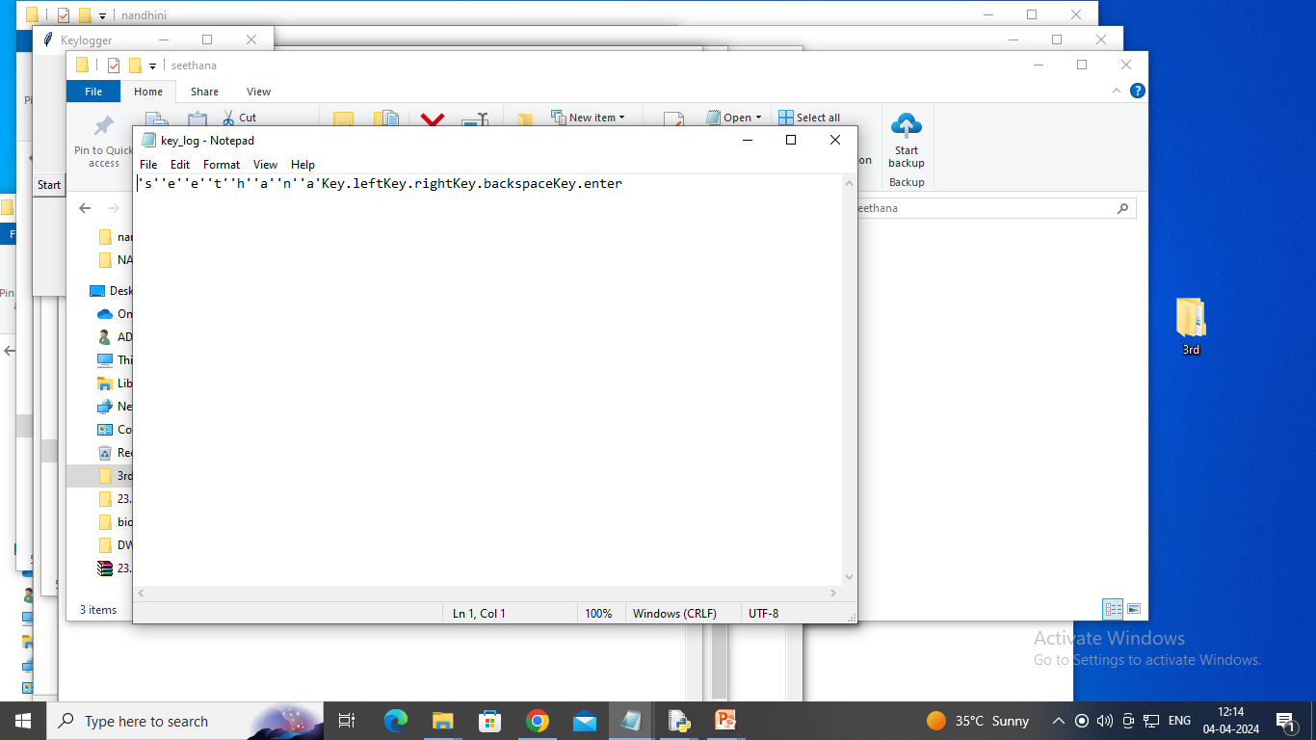

Slide 21
THANK YOU

